Slide 1

Phonics Meeting for Parents
Louise Shanks – Deputy Principal
Phonics Lead and Y1/Y2 teacher
Carla Curtis Y1/Y2 teacher
Lara Keun YR teacher
November 2024

Slide 2
“Synthetic phonics offers the vast majority of young children the best and most direct route to becoming skilled readers and writers”
Sir Jim Rose,
Rose Review of Reading 2006

Slide 3
Why teach phonics?
All staff in school are trained to deliver the Little Wandle Programme
Phonics helps children to develop good reading and spelling skills.
The ability to read and write is a vital skill for all children, paving the way for an enjoyable and successful school experience.
We use a synthetic phonics programme
called ‘Little Wandle for Letters and Sounds’.
Notes:
New scheme
All staff trained

Slide 4
What is synthetic phonics?
Synthetic Phonics is a way of teaching reading.
Children are taught to read letters or groups of letters by saying the sound(s) they represent – so, they are taught that the letter s sounds like s when we say it.
Children can then start to read words by blending the sounds together to make a word.

Slide 5
The Phases
Phase 1 - nursery (pre-school)
Phase 2, 3 and 4 – throughout reception
Phase 5 is taught in year 1
Revision of phase 5 and Bridge to Spelling –year 2
Notes:
Children are having extra phonics lessons this term in year 1 so that by after Christmas we should be back on track with our teaching.

Slide 6
Phonics Screen Check
The Phonics Test is a compulsory test for pupils in year 1 (usually in early June).
The Phonics Screening Test seeks to test whether children have learned to decode words using phonics to the required level.
Children are expected to sound out and blend graphemes to read simple words.
If the children have not reached the required standard in year 1, they will re take the check in year 2, where further support is given.
Notes:
Current year 2 pupils will take the PSC in Autumn due to Covid

Slide 7
How to say the sounds
Saying the sounds correctly with your child is extremely important.
The way we say the sound may well be different from when you were at school.

Slide 8


A phoneme you hear
A grapheme you see
A word doesn’t always have the same number of letters and phonemes!

Slide 9
Segmenting
Recognising the letter sounds in a written word, for example:
c-u-p

Slide 10
Blending
Merging or ‘blending’ the sounds in the order in which they are written to pronounce the word
cup
Speedy recognition of the sound for each letter is really important, so your child can blend them to read words easily.

Slide 11
Tricky Words
Some everyday words in English have tricky spellings and can’t be read by blending.
These are sometimes called high frequency tricky words .
We tell the children to look for any part of the word they know and then try to work out the rest of the word.
Not all of the word is tricky!

Slide 12
Reading and Phonics in Year 2
If your child has passed the phonics screen check, they will revise phase 5 in the Autumn term and then they will work through the Bridge to Spelling Programme
If you child did not pass the phonics screen check in Year 1 they will receive extra phonic support and will be regularly monitored until they pass the check.

Slide 13
Reading sessions in class
These are carried out in small groups as opposed to reading individually – although we do this sometimes.
The child will read the book three times and will focus on these three aspects.
Session 1 is decoding
Session 2 prosidy
Session 3 comprehension

Slide 14
Collins BIG CAT eBooks
Your child will have access to the Big Cat eBook Library You will receive an email address into your inbox inviting them to log into the Collins HUB https://www.collinshub.co.uk/login/

Slide 15
How can I help at home?
Reading lots of books with your child.
Read stories to your child.
Continue to read rhyming books and sing nursery rhymes.
Play rhyming games e.g. How many words can you find that rhyme with jam?
Play ‘I spy’…This will help them to hear the initial sound in words.
Look at the Little Wandle for Letters and Sounds Page
https://www.littlewandlelettersandsounds.org.uk/resources/for-parents/

Slide 16
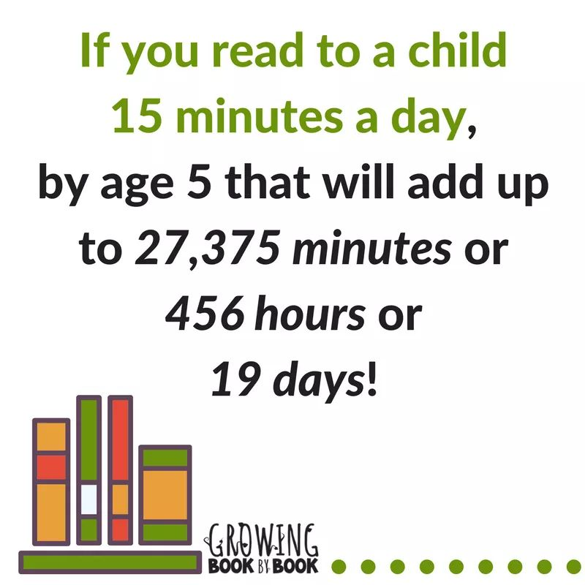

Slide 17
Any Questions?
Please feel free to ask any of us any further questions.
We would appreciate your feedback on the session, so that we can help you further if you need it.

